Slide 1
Overview

Slide 2
Contents
Introduction/History of the Workforce Development Board
Overview of Local Workforce System Program Service Area
WDB Mission and Vision
WDB Committees and Goals
WDB Priorities
Hudson County One Stop Career Centers

Slide 3
Introduction/History of the WDB
The Hudson County/Jersey City Workforce Development Board (WDB) is one 17 WDBs in New Jersey and one of 550+ WDBs in the country.
The WDB is mandated by federal law to be the lead organization in Hudson County and Jersey for workforce planning, to cooperate with State officials in providing business with locally-validated labor market information, and to arrange for a service delivery system that meets the workforce needs of businesses and job-seekers.
The WDB helps to oversee State and Federal dollars that fund programs for adults, dislocated workers, and young people through the Hudson County and Jersey City One Stop Career Centers, where various employment, education, training, and social service organizations provide services to employers and jobseekers.
With the cooperation of the New Jersey Department of Labor and Workforce Development (LWD)’s, the WDB has in place a comprehensive Strategic Plan that focuses its investment strategy on four industry clusters in the Hudson County economy: (1) Healthcare; (2) Transportation, Logistics, Distribution (TLD); (3) Hospitality/Tourism; and (4) Financial Services.
The Hudson County/Jersey City WDB is committed to enhancing Hudson County’s economic growth by aligning workforce strategies with these key industries – engaging businesses and developing programs that are employer driven and enhance skills resulting in a talent-pool that meets the needs of employers.

Slide 4
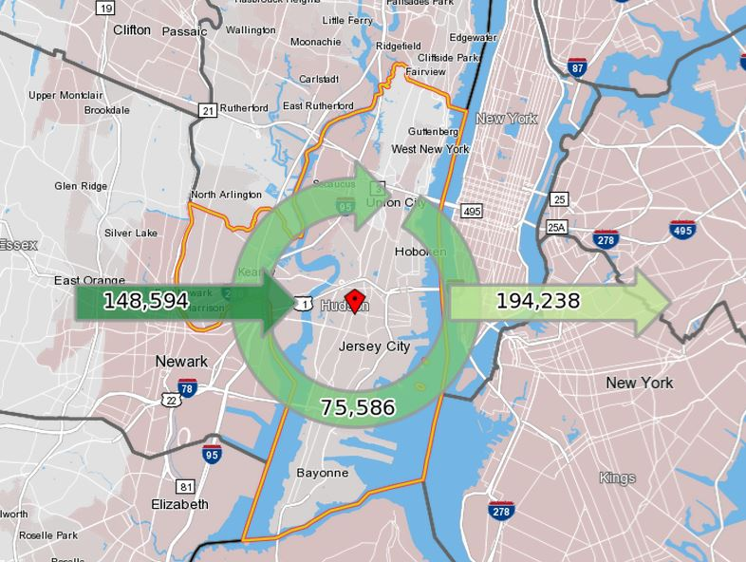
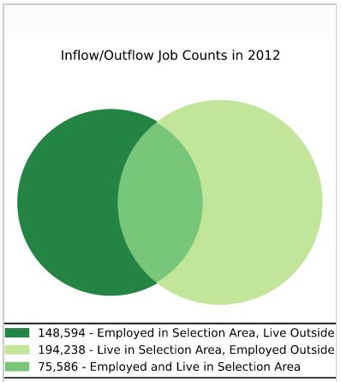
Overview of Local Workforce System Program Service Areas
Hudson County is the most densely and diversely populated county in New Jersey.
Hudson County’s population has increased by almost 4% from 2010 (634,266 residents)¹ to 2013 (660, 282 residents) ².
75,586 Hudson County residents are employed within the County, while about 150,000 individuals commute into Hudson County for employment from surrounding areas and about 195,000 individuals commute out of the County to surrounding areas for employment. ³
Hudson County’s total labor force is expected to rise over the 2010-2020 period (+6.1%). ⁴
By 2020, Hudson County is projected to add 19,550 jobs an increase of 8.1% (slightly above the State’s projected 8%)⁵.
On an annual basis, the County is expected to add jobs at a rate of 0.8%⁶.

Slide 5
Overview of Local Workforce System Program Service Areas
Hudson County | Total
Total Labor Force (2018) | 357,600
Total Employment (2018) | 343,800
Annual Average Unemployment Rate (2018) | 3.9%
Jersey City | Total
Total Labor Force (2018) | 138,953
Total Employment (2018) Annual Average Unemployment Rate (2018) | 133,240 4.1%

Slide 6
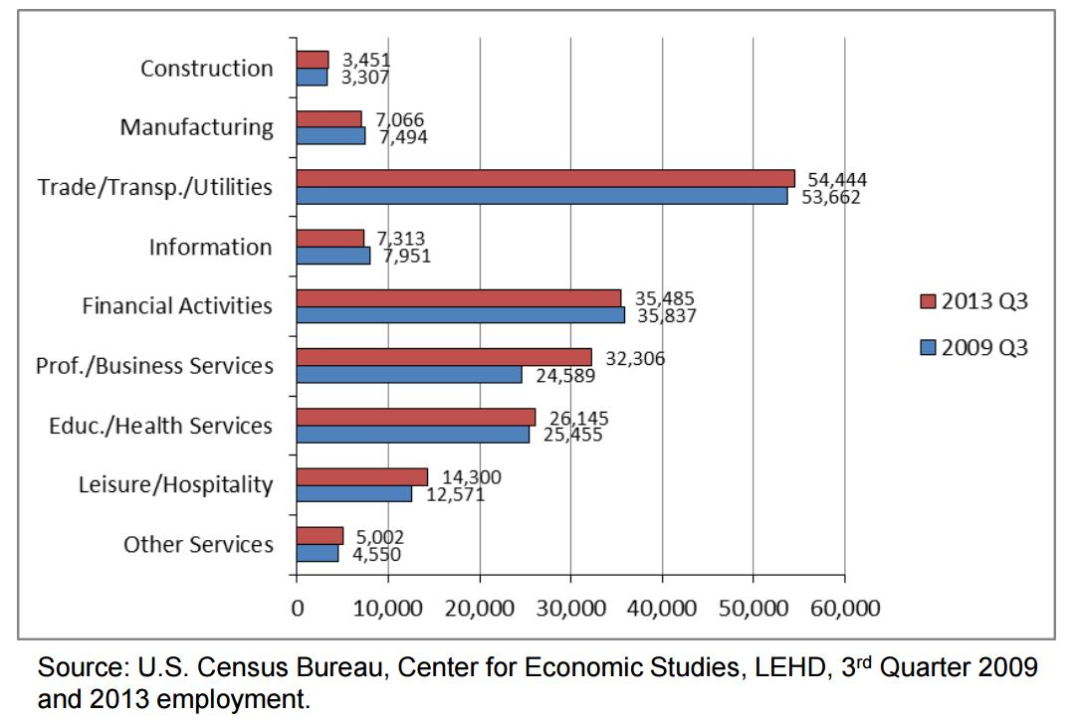
Overview of Local Workforce System Program Service Areas: Industry Sectors
Source: NJ Depart. of Labor & Workforce Development, Quarterly Census of Employment & Wages, Annual Averages

Slide 7
WDB Mission and Vision
The MISSION of the Hudson County/Jersey City WDB is to serve as an alliance of the public and private sector for the purpose of supporting and linking economic development and workforce development initiatives in order to meet the changing needs of job-seekers and employers.
The WDB seeks to create an effective workforce system that will:
Increase economic security and train job-seekers in traditional sectors as well as in fast-growing, well-paying sectors;
Deliver skilled workers that local businesses need to grow and compete;
Align the needs of businesses and jobseekers along common goals and outcomes

Slide 8
WDB Committees and Goals
Currently the Hudson County/Jersey City WDB has five standing committees and an executive committee. The committees meet, as needed, to discuss target populations or specific sector strategies:
Executive Committee – Works closely with the WDB Director between full Board meetings helping to frame issues, and proposing an overall direction and approach for the work of the WDB.
One-Stop Career Center Committee – Provides oversight and guidance in the development of programs; establish and track metrics to ensure that one stops meet or exceeds standards for placement retention, earnings and jobseeker/employer satisfaction.
Disability Committee- Works to enable individuals with disabilities to have universal access to employment opportunities.
Literacy Committee - Identifies and analyzes local resources, programs and services and recommends ways to improve the quantity, quality and delivery of literacy programs.
Youth Investment Council- Aims to strengthen the capacity of education, youth development and training programs to provide high quality services that are aligned with workforce skills required for employment and success

Slide 9
WDB Priorities
The Hudson County/Jersey City WDB’s priorities reflect the priorities of the New Jersey State Employment and Training Commission (SETC), and Jersey City and Hudson County’s economic and workforce development goals:
Invest in workforce development based on industry needs/Increase business participation, awareness, and use of the workforce system in order to meet the needs of local businesses and create new job opportunities.
The WDB will Promote Hudson County/Jersey City’s workforce development system among members of the business community, identify the hiring and training needs of local businesses, begin to develop a more strategic alliance and alignment with key Industries/Sectors by identifying board members and perspective board members to participate in work groups to identify industry needs, and seek to leverage funding from local businesses to expand the scope and variety of workforce and job-training services offered throughout the community.
2.Meet jobseekers where they are.
The WDB works with community based organizations, local colleges and investing in other private-public partnerships to sponsor career fairs, targeted outreach efforts, and other programs to increase re-employment services.
3. Equip the workforce for employment.
The WDB works workforce system partners to provide basic skills, literacy and workforce readiness programs and provides input on the design of services for businesses and jobseekers across the workforce system
4.Increase system accountability/Support Hudson County/Jersey City workforce services and conduct effective oversight of the WIOA-supported system.
The WDB seeks to hold the all of the workforce system partners accountable to high standards of quality and performance.
5. Prioritize talent development resource investments for individuals with disabilities, veterans, youth, and the long-term unemployed

Slide 10
WDB Priorities
The WDB will also work to:
Leverage resources and promote public/private partnerships, (including promoting additional OJT programs, which encourage businesses to hire by offering to defray the cost of training new employees while they develop skills.
Provide local labor market information and analysis of important industry and workforce trends to generate effective programming, using as a guide post, the “Talent Networks,” identified by New Jersey’s Unified Workforce Investment Plan:
Advanced Manufacturing
Bio/Pharma/Life Science; Health Care
Financial Services
Technology/Entrepreneurial
Transportation
Retail, Hospitality and Tourism
Encourage adoption of best practices and response to important workforce news and issues.

Slide 11
WDB Roles: Members
The Board must consist of a majority of private sector members. The WDB also includes membership from education, organized labor, employment and training, human services and community based organizations.
The WDB Chairperson and Vice-Chair are selected from among the Board members.
Board Members’ responsibilities include:
Generate ideas to improve and strengthen workforce programs;
Hold the system accountable to high standards of quality and performance;
Provide input on design of workforce services;
Increase Business Investment/Recruit business leaders to serve as WDB members;
Promote Hudson County/Jersey City’s workforce system in the business community;
Use the workforce system by helping to identify potential new business customers;
Leverage business resources to enhance and expand workforce programs.

Slide 12
WDB Roles: Staff
The responsibilities of the WDB Staff include:
Researching and informing Board members about workforce trends and events, state and national policies, and best practices.
Informing Board members about proposed developments to the City and County’s workforce system.
Engaging workforce partners and proposing ways to leverage resources and applying for new funds.
Supporting the day-to-day planning of committees and operations of Labor Market Information.
Servicing website, consultant contracts, assisting with grant applications.

Slide 13
WDB Meetings
The primary function of the Full Board is to bring members together to develop policies, provide guidance and recommendations for the County’s One Stop Career System. Partners. Additionally, the Board shared information on currently working projects.
The Full Board meets quarterly.
The Executive Committee meets when necessary.

Slide 14
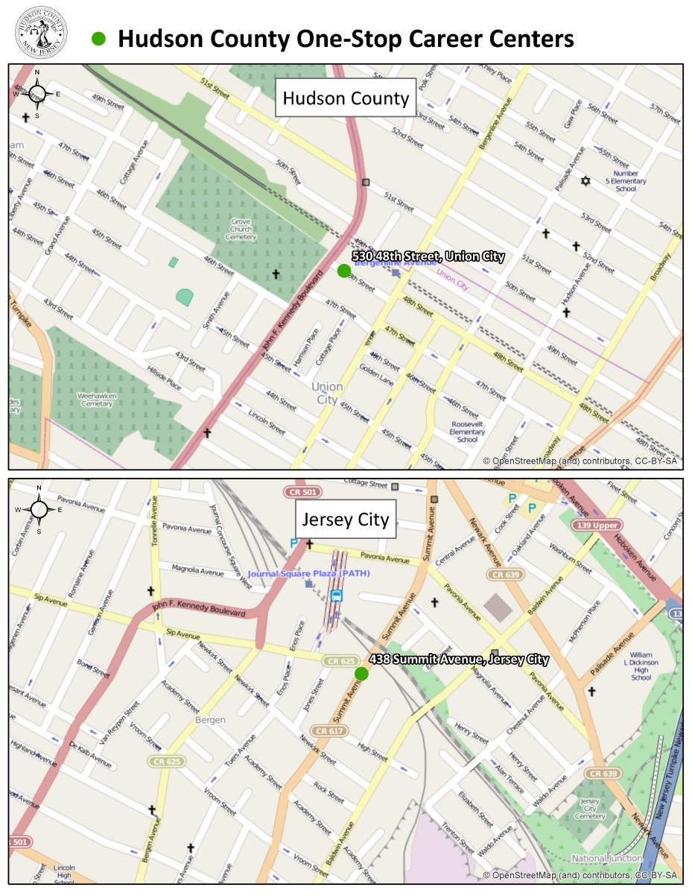
One Stop Career Centers
The Workforce Innovation and Opportunity Act (WIOA) requires a system of state and local agency partners to provide the community with a quality, accessible and comprehensive system of labor market information and education/training programs for employers, job seekers and the community and to serve as a connecting point between job-seekers and employers.

Slide 15
Overview of WIOA
The Workforce Innovation and Opportunity Act (WIOA), which supersedes the Workforce Investment Act (WIA) of 1998, presents an extraordinary opportunity to improve job and career options for our nation’s workers and jobseekers through an integrated, job-driven public workforce system that links diverse talent to businesses. The WIOA supports the development of strong, vibrant regional economies where businesses thrive and people want to live and work.
One of the first steps in implementing WIOA is reestablishing WDBs in all local areas to meet the law’s new provisions. The WIOA Section 107(a) prescribes that there shall be established in each local area (certified by the Governor) a local WDB to lead workforce investment and development activities for the area.

Slide 16
Key WIOA Facts
WIOA differs from WIA in the following ways :
Name change! From Workforce Investment Board (WIB) → to Workforce Development Board (WBD)
Reduces the number of members on the Workforce Boards
Emphasizes a regional approach and alignment with economic development goals
Enhances performance accountability with common measures across core programs
Requires system plans at the State and Local levels
Diversifies training programs to close the skills gap

Slide 17
Current Initiatives
Opportunity Partnership Grant – Solar Panel Technician/Solar Energy Technician training program
The Hudson County Building & Construction Trades Council – NJ BUILD Women and Minorities in Construction grant program
Development of a full service Youth One-Stop Career Center

Slide 18
Strategic Action Plan (2015-2016)
1. Transition the Hudson County/Jersey City workforce structure properly according the WIOA guidelines.
2. Become more data & performance outcome driven.
3.Invest in workforce development cased on industry needs.
4.Prioritize talent development resource investments for youth, small businesses, immigrants, and other underserved populations.
5. Execute new marketing approach.

Slide 19
Data Sources
Profile of General Population and Housing Characteristics: 2010 (US Census)
Annual Estimates of the Resident Population for Selected Age Groups by Sex for the United States, States, Counties, and Puerto Rico Commonwealth and Municipios: April 1, 2010 to July 1, 2013 (US Census)
Inflow/Outflow Job Counts in 2012, Census Bureau
NJ Department of Labor & Workforce Development, Population & Labor Force Projections
“Key Industries in Hudson County”, NJ Department of Labor and Workforce Development, September 2013.
“Key Industries in Hudson County”, NJ Department of Labor and Workforce Development, September 2013.
NJ Department of Labor & Workforce Development
2010-2012 3-year Estimates, US Census
CA1-3 Personal income summary, US Bureau of Economic Analysis
Picture Sources
Slide 2: www.commerce.gov
Slide 5: Hudson County Division of Planning
Slide 10: mazzonehospitality.com
Slide 11: everydaylife.globalpost.com
Slide 13: brevidia.com

Slide 20
Q & A

